Slide 1




Innovation policy for green energy and energy efficiency in Sub-Saharan Africa
Based on the project “Strategy of Green Technology and Green Industry in Africa”
. A Study of Renewable Energy Technology Market, and Energy Efficiency Adoption in Cassava and Maize Processing Industries in Kenya and Nigeria.
Funded by KEEI through UNIDO
René Kemp
UNU-MERIT and ICIS
Paper for Lundvall symposium “Innovation policy – can it make a difference?”
Utzon Center, Aalborg, Denmark
13‐14 March 2014

Slide 2
What the study is about
The market for modern renewable energy technologies (RET) in Sub-Saharan Africa, and
The uptake of energy efficiency (EE) measures in two agro-industrial sectors (cassava processing and maize milling) in two African countries (Nigeria and Kenya)

Slide 3
Background of the study
Renewable energy (RE) is spreading across (energy poor) Sub-Saharan Africa (SSA) but few studies have engaged in orginal data analysis on this.
Agro-industrial sectors constitute an important part of the economy in SSA, which makes them suited for an analysis of the prospects for green industrial development from an energy-using point of view.

Slide 4
Global Trends in Renewable Energy Investments (2012)
USD bn
Middle East and Africa
4
Rest of World
5
12
3
2
2
1
1
1
2004
2005
2006
2007
2008
2009
2010
2011
2012
Source: UNEP Global Trends in Renewable Energy Investments (2013).

Slide 5
Trends in Wind Installed Capacity
MW
Africa
1.021
Rest of World
919
281.409
237.116
2000
2001
2002
2003
2004
2005
2006
2007
2008
2009
2010
2011
2012
Source: Global Wind Statistics 2012 (GWEC)

Slide 6
Trends in Solar Installed Capacity
MW
Middle East and Africa
601
Rest of World
192
101.555
71
70.869
25
40.599
3
23.580
5.364
2000
2001
2002
2003
2004
2005
2006
2007
2008
2009
2010
2011
2012
Source: EPIA Global Market Outlook for Photovoltaics (2013).

Slide 7
Investments in Renewable Energy in Africa (2012)
USD bn
South Africa
5.70
Morocco
1.80
Kenya
1.10
Ethiopia
0.40
Note: omits countries with less than USD 0.1 bn investment.
Source: UNEP Global Trends in Renewable Energy Investments (2013).

Slide 8
Source: Ministry of Energy and Petroleum of Kenya

Slide 9
Source: Ministry of Energy and Petroleum of Kenya

Slide 10
RE potential for electricity in Kenya
Resource type | Potential | Current capacity
Hydroelectric power | - 3,000MW in small hydro - 6,000MW comprising of large and small hydro plants | Large hydro power: 807MW Small hydro power: 25MW
Solar Energy | 4-6kWh/m²/day | - Small PV systems with capacity of 12-50Watts - PV systems: 1,450kW in 450 institutions
Wind | - 346W/m² - wind speed ranges 8-14m/s in some areas and have potential to produce over 1,000MW | 5.45MW (June, 2010), and further 20MW (2013)
Geothermal | 7,000-10,000MWe in 14 potential sites in Rift Valley | 212MW
Biomass | - co-generation using sugarcane bagasse up to 193MW - more opportunities up to 300MW
Biogas | 1,000MW
Sources: National Energy Policy Report (2013); Renewable Energy Portal, Energy Regulatory Commission; Institute of Economic Affairs, Kenya (2013)

Slide 11
Key research questions
What are the trends in renewable energy technology deployment and investment across various world regions, and how does investment in SSA compare with these global trends?
What are the product offerings and market prospects for RET (solar, wind, biomass, hydro) in Nigeria and Kenya?
What factors shape the diffusion of RET in Nigeria and Kenya?
What are the factors behind the choice and adoption of EE and RETs in agro-industrial sectors? What factors are preventing companies from investing more in EE and RET?
Is there a need for technical cooperation in RET and EE? If so, what form should this take?

Slide 12
The research approach
The research questions are assessed through two specially designed questionnaires, interviews with companies and experts and desk research
The project draws on the literature on diffusion and adoption of new technologies, the literature on innovation systems and the literature about global value chains.
Local and global aspects of value chains and innovation are being brought into the analysis, helping us to understand the indigenous and foreign sources of knowledge and technology, the need for financial assistance, technology transfer and technical cooperation.

Slide 13
The research sample
The survey sample consists of 22 RET suppliers/marketers and 62 cassava processing firms in Nigeria; and 41 RET suppliers/marketers and 40 maize processing firms in Kenya.
The project also included 12 mini-cases of RET supply and adoption and EE adoption (6 in Nigeria and 6 in Kenya).

Slide 14
The RET sample for Kenya
Number of employees

Slide 15
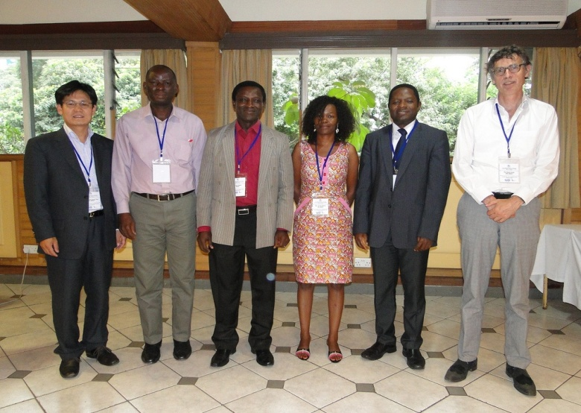
The research team
The research teams involves development specialists, innovation researchers and policy experts from Africa and Europe and is led by UNU-MERIT

Slide 16
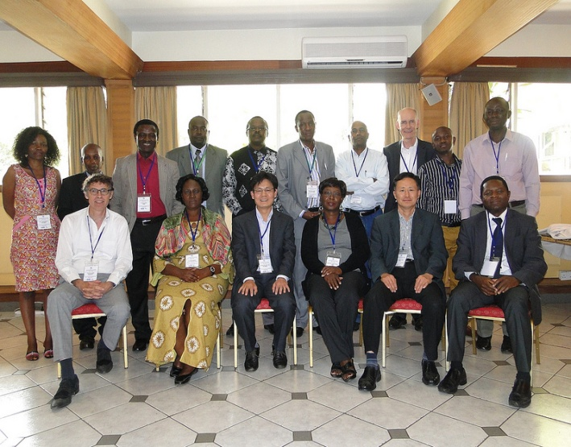
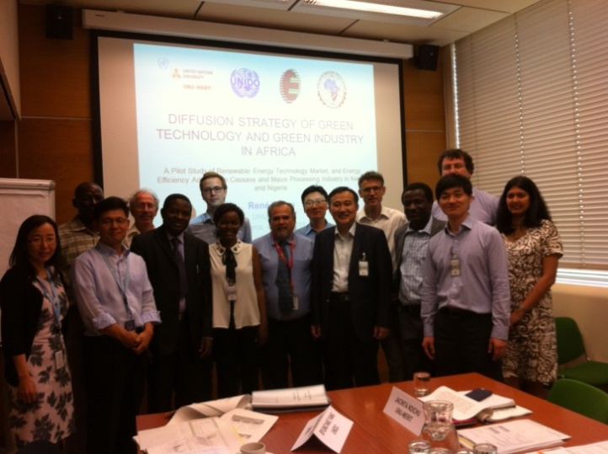
Time line
Sept 2012
Dec 2012
Jan 2013
Febr 2013
May – June 2013
June 2013
Aug 2013
Sept 2013
Nov 2013
March2014
Start of the project
Workshop in Brussels
Report about analytical framework
2nd workshop in Brussel
Field-work
Policy makers workshop in Nairobi
1st draft report
2nd draft report
Vienna workshop at UNIDO
Final version of report

Slide 17
Key findings
The RET sectors are young (and small): Most of the solar technology suppliers and almost all bioenergy and wind turbine companies which were examined in Kenya have been established after 2000.
Solar and biomass are the biggest RET markets in terms of suppliers with solar PV being based on foreign technology and biomass mostly based on domestic T and knowhow
The majority of the suppliers are not experiencing growth (82% in Nigeria and 71% in Kenya) but they are very positive about futures sales
We did not observe energy leapfrogging and do not consider this a realistic option for SSA
There are many constraints to diffusion (a “web of constraints”)

Slide 18
The adopters
The most important adopters of RET are government and not-for-profit organisations (schools, hospitals community centres)
Modern RET uptake by industry is slow (main energy need is for heat and for this wood products and FF are used).
There is a potentially big market for biogas and biobricks for the reason that FF are expensive and energy costs being a significant cost item for many agro-industrial sectors
Few companies have adopted sophisticated energy efficiency measures. Reasons for this are: High costs of adoption, problems of technical capability, risk perceptions. (Energy losses in the manufacturing sector are considerable : between 10-40 percent according to KAM-Center for Energy Efficiency & Conservation).
Many of the potential adopters want to see the technology in operation: demonstration effect, possibility to have a conversation with trustworthy user.

Slide 19
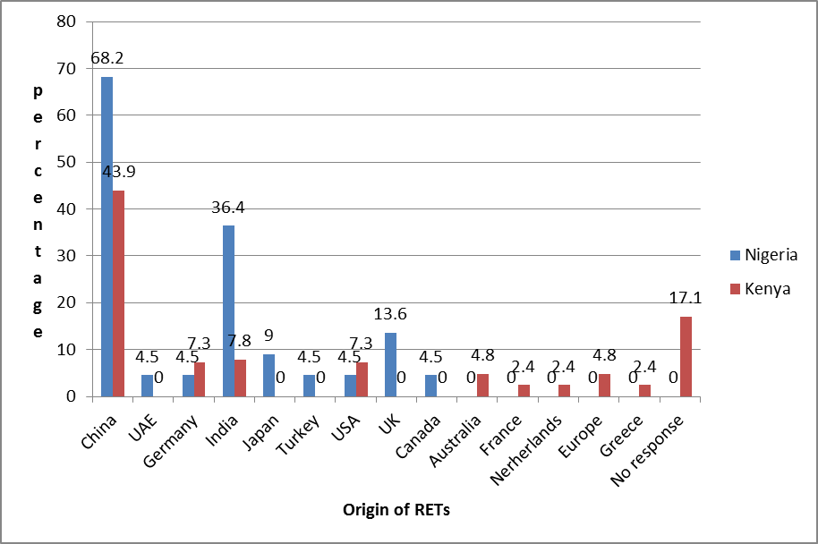
Origin of foreign suppliers of RETs

Slide 20
China is an important supplier of RET Why?
  Chinese companies can supply products of any desired quality at a price matching the quality
  There is a great deal of trading between Africa and China with African traders/entrepreneurs going to China
  China has a presence (with great visibility) in Africa
  The Chinese government encourages exports into Africa and has exchange programmes
  Kenyan business has representatives in China
  High level contacts exist between China and African countries (trade and cooperation visits)
  ...

Slide 21
Reasons for adopting RET
Unreliable and sporadic power supply in Nigeria
Access to electricity in places without a power grid
High energy costs at times of drought in Kenya (when users must import power because the hydropower-based infrastructure is incapable to supply sufficient power).
In Kenya the volatility of the foreign exchange rate also acts as a positive stimulus for RET deployment as changes in the exchange rate affect the electricity utility costs. The influence of feed-in tariff was mixed. Access to finance is an important factor for almost all. In Kenya, NGOs played a much more important role in the adoption of RET than in Nigeria

Slide 22
Barriers
'Unfavorable business climate/environment for FDI” , “Import tariffs' and 'lack of technical competence on the part of potential adopters' are the three most often stated barriers to the adoption of RETs
Financial aid and technical assistance are viewed as important factors for wider diffusion
To deal with obstacles, RET suppliers offer specific services to reduce shortcomings: help with implementation, training, after sales care, advice on finance and payment in installments. The provision of bundled services is a strategy to overcome weaknesses of the innovation system

Slide 23
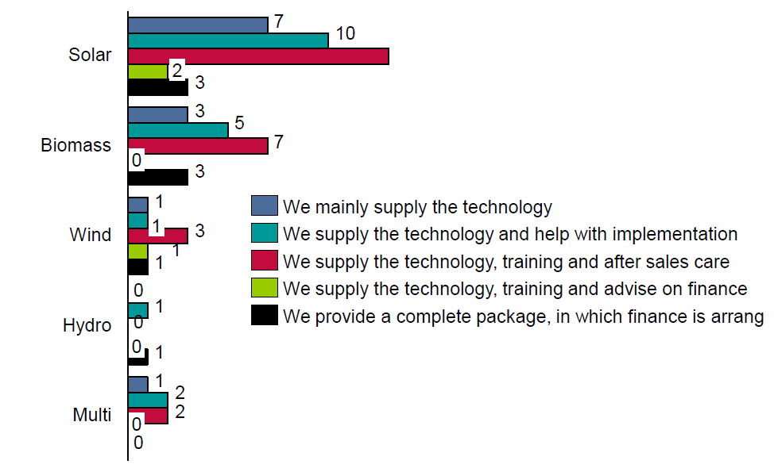
Services provided by RET suppliers in Kenya

Slide 24
Overview of energy efficiency (EE) measures adopted

Slide 25
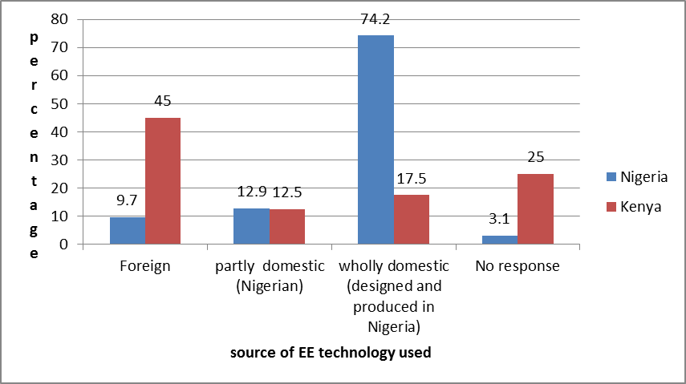
Source of EE technology components

Slide 26
Countries from which the technologies are sourced

Slide 27
Supply offerings

Slide 28
Organisations involved in successful EE projects

Slide 29
Importance of consultancy /external advisors for EE project success
Necessity of consultancy /external advisors for EE project success | Nigeria |  | Kenya
 | Frequency | Percentage | Frequency | Percentage
Not necessary | 13 | 21 | 4 | 10
Very necessary | 20 | 32 | 16 | 40
Necessary | 20 | 32 | 12 | 30
Undecided | 09 | 15 | 8 | 20
Total | 62 | 100 | 40 | 100
Services provided | Frequency | Percentage | Frequency | Percentage
Assist in equipment acquisition only | 3 | 7.5 | 0 | 0
Supply and installation of equipment | 6 | 15 | 7 | 25
Introduction of modern technology; advisory services/ capacity building | 17 | 42.5 | 9 | 32.1
Equipment acquisition and training | 14 | 35 | 3 | 10.7
Energy audit | 0 | 0 | 4 | 14.3
Equipment modifications | 0 | 0 | 5 | 17.9
Total | 40 | 100 | 28 | 100

Slide 30
Informal learning as an important source of learning

Slide 31
Implications for innovation policy
African governments are interested in renewable energy (RE) and energy efficiency (EE)
They are looking for guidance to support RE and EE
There are no simple recipies for creating a more enabling enviroment for RE and EE because policy is a PROCESS requiring
  Capacities for policy making and coordination
  Mechanisms for implementation and enforcement
  Policy learning (to adapt policies to new circumstances)
  An ability to avoid falling prey to special interests, to hypes and short-termism
  → Get the process right!!

Slide 32
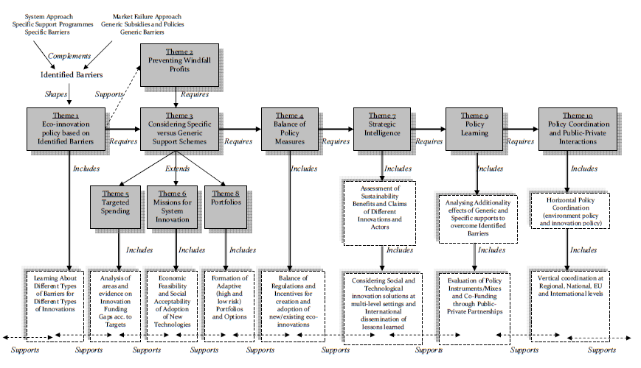
10 themes for eco-innovation policy
Source: Kemp in article for S.A.P.I.E.N.S (2011)

Slide 33
Cooperation as a model for technical learning and building innovation capabilities

Slide 34
Technical cooperation models
1) Development aid model
2) Development finance institution model
3) South-South model
4) Intra-Africa model
5) Going out models
6) Enterprises’ initiative model

Slide 35
About the TC models
1) Development aid model: Projects last only a few years, NGOs lacking technical competence resulting inappropriate solutions, need for local champion (knowledge broker).
2) Development finance institution (DFI) model: Offering finance to firms and state agencies, several IPP are associated with DFI; projects can take long to attain financial closure, crowding out of local and foreign private investors, neglect of small-medium scale projects, DFI tend to finance projects with technologies from their countries
3) South-South model: This consists of organisations from (mostly) BRICS countries trading/cooperating with African countries.
4) Intra-Africa model: Consultancy expert services from Africans to Africans

Slide 36
TC models cont.
5) Going out models:
GO model of China consists of state support to (state-owned) enterprises in the form of financial resources, customisation of packages, absence of rules for conduct, continuity, presence and visibility in Africa, focus is on commodities and infrastructure;
GO model of NL consists of offering co-financing, risk mitigation instruments, trade missions, plus technical and business advice to private sector endeavours into Africa; Chambers of commerce are playing the crucial role of organizing Dutch enterpreneurs in various sectors (water, energy). Brokering services are provided by the NL-Africa Business council and commercial attachees in destination countries.
6) Enterprises’ initiative model: Business clubs set up by banks offering seminars and workshops, opportunities for networking, and organised tours to important trade goods markets (which differ from government driven trade tours in allowing a greater participation from small business) (thus far only one trip to D and NL has been organised by the Barclay Kenya Business Club)

Slide 37
Our ‘evaluation’ of the “technology cooperation” models is that
All models have a role to play but all suffer from weaknesses
Development aid grants distort markets and create non-sustainable dependencies of financial support.
The technology transfers from aid and trade do little to improve weaknesses of the eco-innovation system
The “going out” economic models involve ample opportunities for technology transfer and adoption especially in key sectors that have potential in transforming SSA economies but opportunities for real technical cooperation are missed (on both sides).

Slide 38
It is proposed that TC focusses more on
Mutual learning and adaptation. Three ways to do this are: 1) through training and education, 2) by adapting foreign technologies, and 3) by improving African solutions
Development aid and DFI supported technical cooperation should target areas of economic production where they have higher chances of making a (lasting) impact, thanks to a functional organisational framework, ability to self-evaluate needs and identify appropriate technologies
Capacity building at the level of government. Low-carbon development paths require “analytical and institutional capacities […] to analyse and interpret the data, to organise and participate in meaningful stakeholder involvement, and to translate background information into (policy) action” (van Tilburg et al. 2011, p. 30). (Such capacities can only partially be provided by international experts: “if the role of the international experts in the strategy process is too large, this could lead to low legitimacy of the LCDS and lack of ownership”.

